Slide 1
Lesson objective
PBiS Focus
Respect (listening)
Learn (participation)
Title: Understanding percentages
Aim:
Describe the meaning of percentage
Convert and shade percentages
Plan:
Notes
Converting and shading
Whiteboards and calculators

Slide 2
Fractions
Decimals
Numerator ÷ Denominator
÷ 100
x 100
Number over 100, simplify
Percentages
Draw diagram for notes
FDP millionnaire.ppt

Slide 3
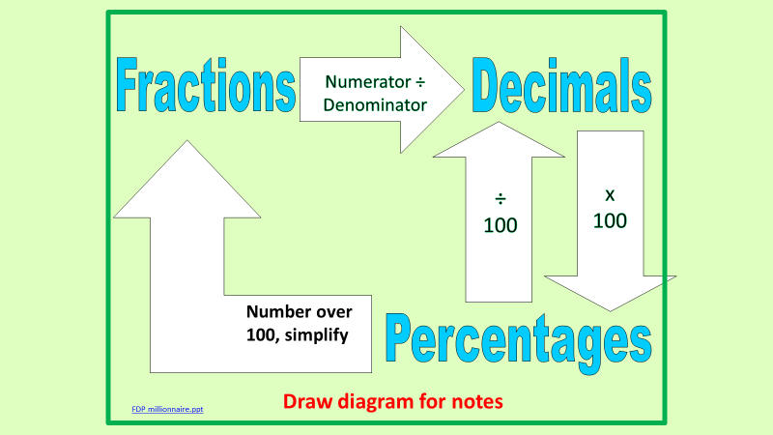
Daily review
Re-teach
Fraction
95/100
Decimal
0.2
0.35
Percent
70%
35%

Slide 4
Whiteboards
Decimal
0.16
?
0.76
?
Percent
55%
21%
Fraction

Slide 5
Quick video
https://www.youtube.com/watch?v=09IOHCf9jUE

Slide 6
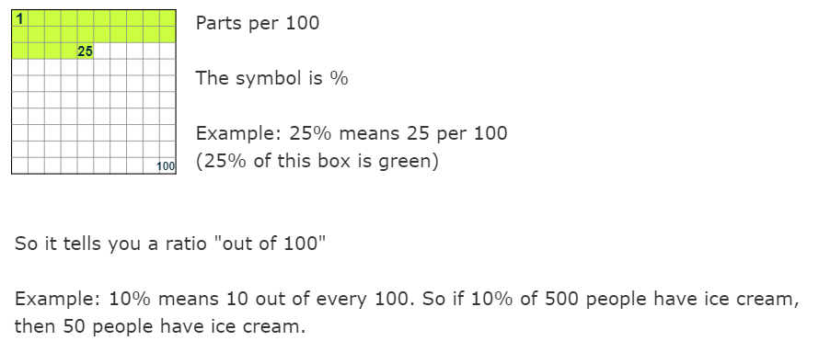

Slide 7

Percent means
Percent means parts per 100
23% means 23 parts per 100 ➔ $\frac{23}{100}$
76% means 76 parts per 100 ➔ $\frac{76}{100}$
15% means ……

Slide 8
Individual practice
Complete the following questions
Use a calculator to assist
Shade 1%
Shade 23%

Slide 9
Reflect
What does percentage mean?
What percent of this shape is shaded?
Fist to 5
I can state percentage means
I can convert and shade percentages

Slide 10
Percent of amounts
10%
5%
1%

